Slide 1

Slide 1
PRESENTING
SAMP
Student Asset Management & Planner

Slide 2
PROBLEM STATEMENT AND APPROACH
To design a budgeting tool for college students to help manage their expenses and savings
We preferred to approach the above problem statement by developing a web application which allows the college students to keep a track of their day-to-day savings and expenses and provide a personalized experience to the user .
The major features of the application include the Machine Learning model which will predict future expenses and alert the user against non-essential expenditure. Also , the application comes with a personalized savings calculator which will calculate and alert the user about how much amount is to be saved daily in order to achieve a desired goal , such as to buy a laptop or pay for the college fees , etc.

Slide 3
Slide 3
GENERAL PROBLEMS
e
52%
41.6%
Students face serious monetary challenges
Students are under 1lakh-5lakh household income margin.
50% +
20.8%
Students require financial assistance and proper budgeting plan.
Students are below the poverty line in the college.

Slide 4



Slide 5
OUR SOLUTIONS
Expenses Tracking
Budget Planning
Goal Setting
This application allows the students to efficiently manage their expenses and put restrictions accordingly.
It allows the students to monitor their spendings on different domains , be it travel , food and others.
Our Solution enables
our clients ,mostly students to set financial goals and help them save up emergency funds, buying commodities, etc.
Your logo

Slide 5



Slide 5
OUR SOLUTIONS
Reminders & Alerts
Visual Reports & Analytics
The Exclusive Savings Calculators
Send notifications to students when they are approaching or exceeding their budget limits in specific categories, or when bills are due.
Provide visual representations of students' spending habits, savings progress, and overall financial health through charts, graphs, and summaries.
Provide calculators to help students estimate how much they need to save each month to reach their financial goals within a specific timeframe.
5

Slide 6


Slide 7
FINANCIAL GROWTH PERSPECTIVES
We expect to generate income through our premium membership model after 2.5 months of ground testing of the existing model.
A very nominal premium shall be charged from the user in exchange of additional features which include a personalized savings calculator.

Slide 7
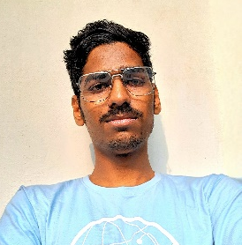
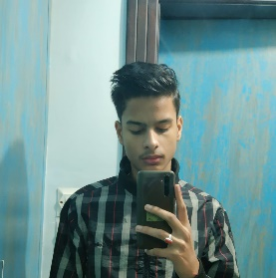
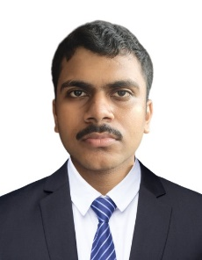
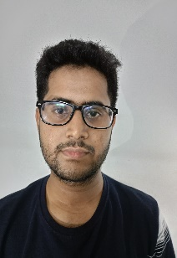

Team SAMP
SAMP
Mrinmoy Koiri
Krishna Harlalka
Mainak Das
Tahmid Choudhury
Biswaraj Dey
B.Tech 1st Year
R.No.: 2313046 Electrical Engineering
B.Tech 1st Year
R.No.: 2313066 Electrical Engineering
B.Tech 1st Year
R.No.: 2312161 Computer Science & Engineering
B.Tech 1st Year
R.No.: 2311140 Civil Engineering
B.Tech 1st Year
R.No.: 2313053 Electrical Engineering

Slide 8

Slide 11
THANK YOU

